Slide 1
Programming II
(C Programming Language)
Loops in C
(Part II)
Lecture 8, Wednesday February 17, 2021
Dr. Ayman ALJARBOUH

Slide 2
Outline
continue Statement in C Loops
goto Statement in C
The Infinite Loop
break Statement in C Loops

Slide 3
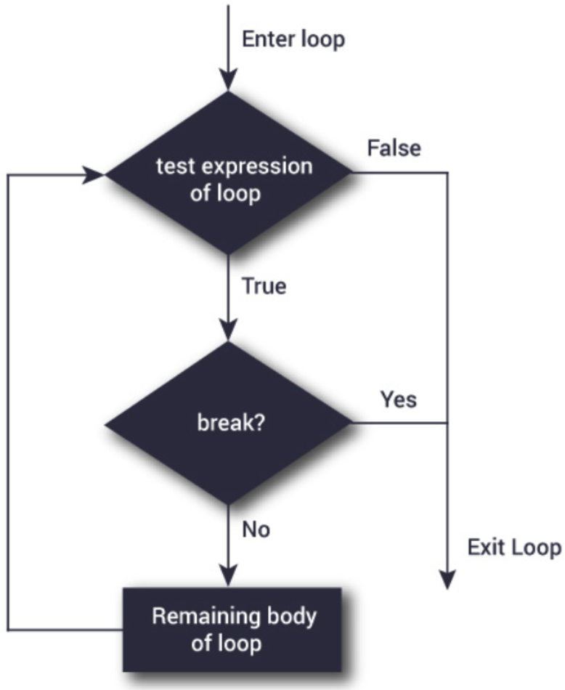

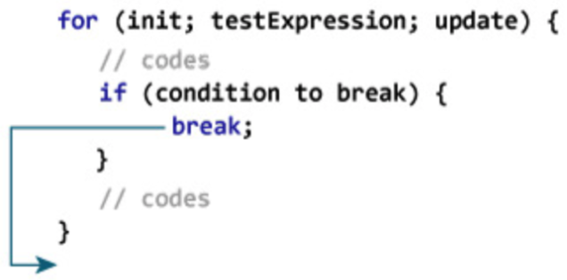
break Statement in C Loops
The break statement terminates the loop containing it
The syntax of break is:
The break statement can be used with for, while and do…while loops:
The flowchart of break in a loop

Slide 4
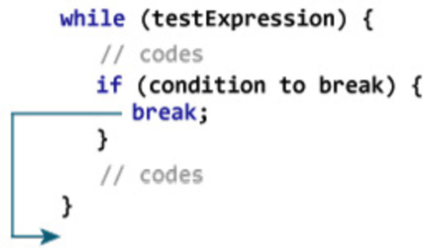
break Statement in C Loops
The break statement terminates the loop containing it
The syntax of break is:
The break statement can be used with for, while and do…while loops:
The flowchart of break in a loop

Slide 5
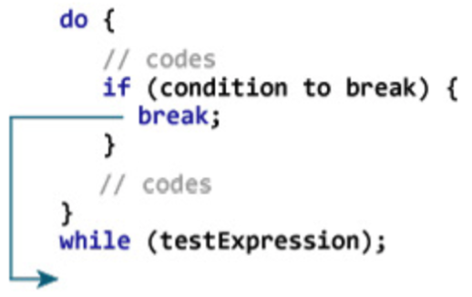
break Statement in C Loops
The break statement terminates the loop containing it
The syntax of break is:
The break statement can be used with for, while and do…while loops:
The flowchart of break in a loop

Slide 6
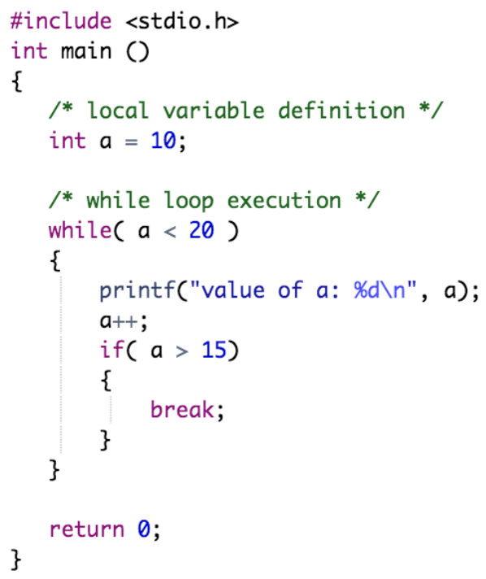
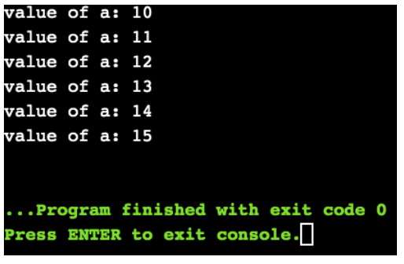
break Statement in C Loops
Output:
Example:
In this program, when a becomes 16, the break statement is executed. This will end the while loop

Slide 7
Outline
continue Statement in C Loops
goto Statement in C
The Infinite Loop
break Statement in C Loops

Slide 8
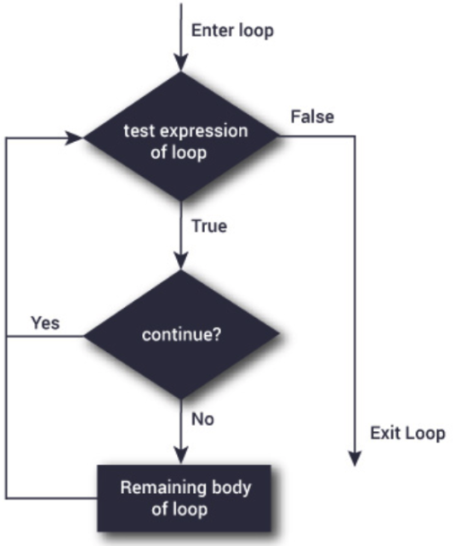

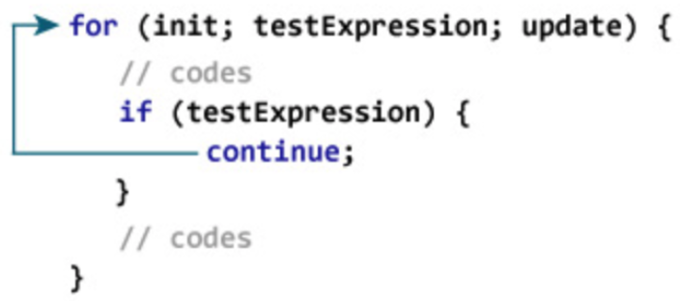
continue Statement in C Loops
The continue statement is used to skip the loop code for an iteration only
The syntax of continue is:
The continue statement can be used with for, while and do…while loops:
The flowchart of continue in a loop

Slide 9
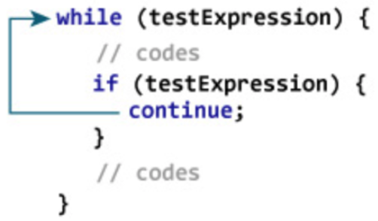
continue Statement in C Loops
The continue statement is used to skip the loop code for an iteration only
The syntax of continue is:
The continue statement can be used with for, while and do…while loops:
The flowchart of continue in a loop

Slide 10
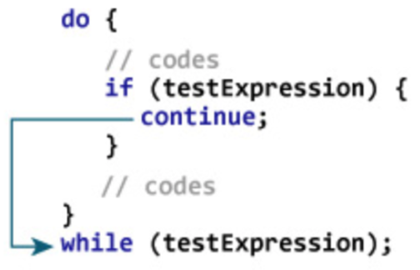
continue Statement in C Loops
The continue statement is used to skip the loop code for an iteration only
The syntax of continue is:
The continue statement can be used with for, while and do…while loops:
The flowchart of continue in a loop

Slide 11
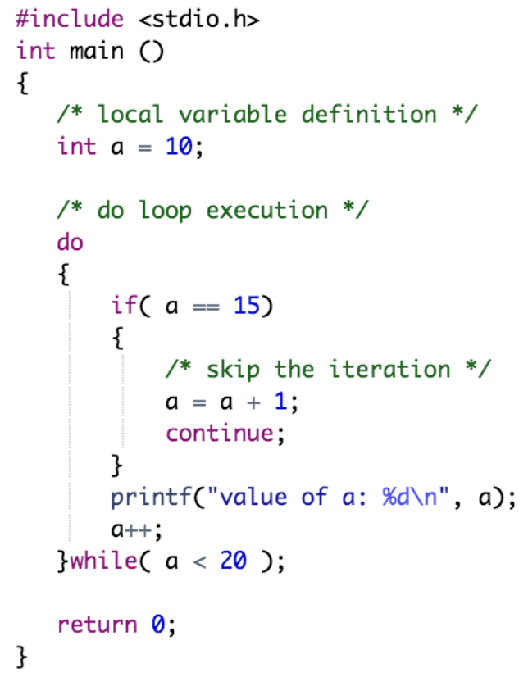
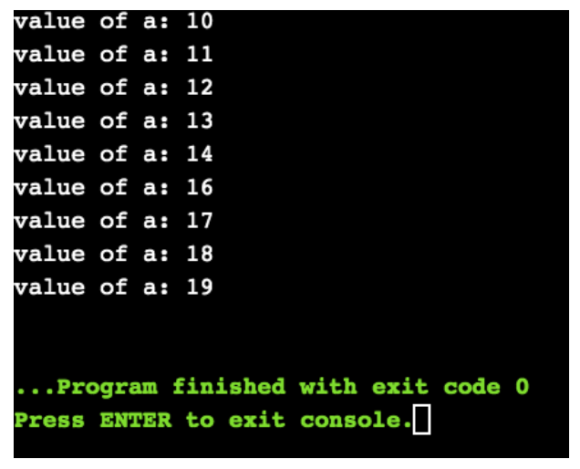
continue Statement in C Loops
Output:
Example:
In the above program, when a becomes 15, the iteration is skipped, and the program jumps to the next iteration

Slide 12
Outline
continue Statement in C Loops
goto Statement in C
The Infinite Loop
break Statement in C Loops

Slide 13
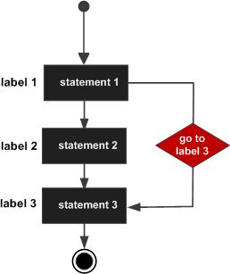
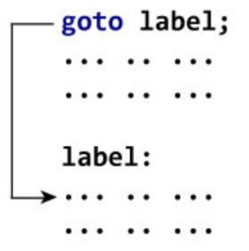
goto Statement in C
The goto statement provides a jump to a labelled statement
The syntax of goto is:
The label is an identifier. It can be any plain text except C keyword and it can be set anywhere in the C program above or below to goto statement
The flowchart of goto statement

Slide 14
goto Statement in C
The goto statement provides a jump to a labelled statement
The syntax of goto is:
When the goto statement is encountered, the control of the program jumps to label: and starts executing the code
The flowchart of goto statement

Slide 15
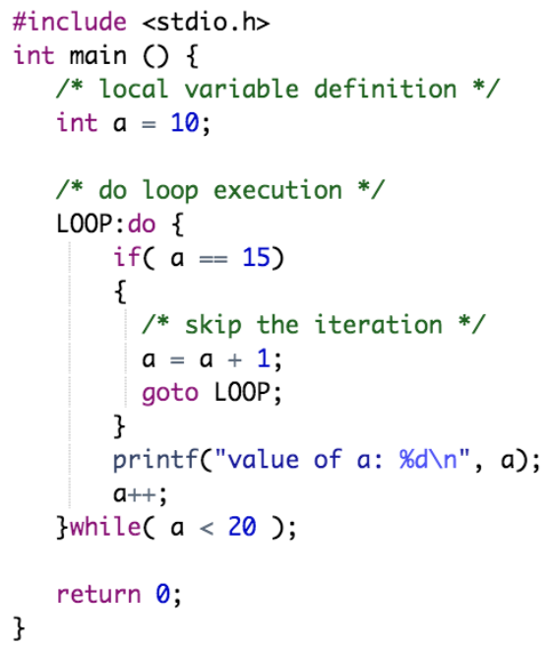
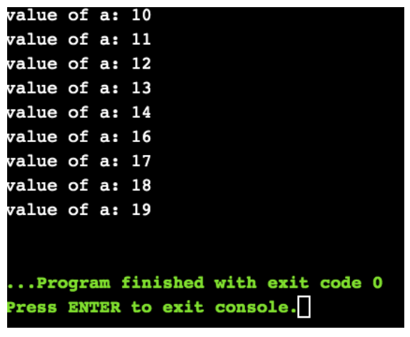
goto Statement in C
Output:
Example:
In the above program, when a becomes 15, the iteration is skipped, and the program jumps to the next iteration

Slide 16
goto Statement in C
SHOULD YOU USE GOTO?
NOTE:
The use of goto may lead to code that is buggy and hard to follow
Use of goto statement is highly discouraged in any programming language because it makes difficult to trace the control flow of a program, making the program hard to understand and hard to modify
Any program that uses a goto can be rewritten so that it doesn't need the goto
Here's a quote from Bjarne Stroustrup, creator of C++, "The fact that 'goto' can do anything is exactly why we don't use it"

Slide 17
Outline
continue Statement in C Loops
goto Statement in C Loops
The Infinite Loop
break Statement in C Loops

Slide 18
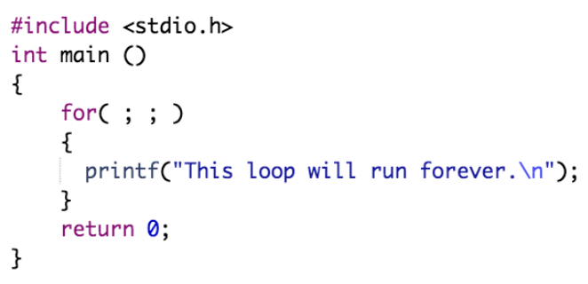
The Infinite Loop
A loop becomes infinite loop if a condition never becomes false. You can terminate an infinite loop by pressing Ctrl + C keys
Example:
When the conditional expression is absent, it is assumed to be true.
C programmers more commonly use the for(;;) construct to signify an infinite loop

Slide 19
Practical Exercises
Write and Compile the following C programs:
Program 1:

Slide 20
Practical Exercises
Write and Compile the following C programs:
Program 2:

Slide 21
Practical Exercises
Write and Compile the following C programs:
Program 3:

Slide 22
Practical Exercises
Write and Compile the following C programs:
Program 4:

